Slide 1

Application Programming Interface
Present by :– Mansi C. Satani
Class:- TYBCA-C
Roll no:-143
Exam no:-3271
Project Guide:- Prof. Eeva Kapopara

Slide 2
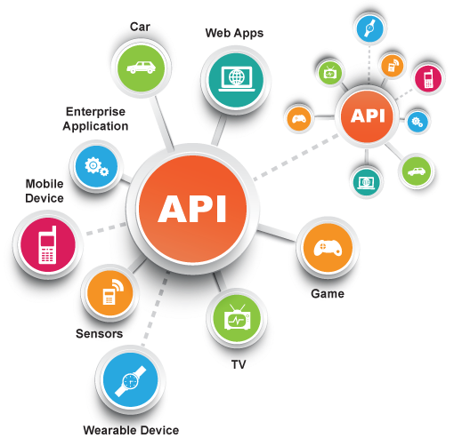
Agenda
What is an API?
How API works?
Examples of an API?
What is API key?
Why API?
What is synchronous/asynchronous API?
Types of APIs
API specifications/protocols
Enterprise analysis of protocols

Slide 3
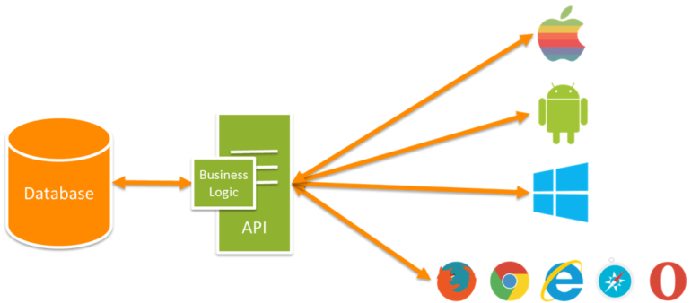
What is an API?
An API is a set of programming code that enables data transmission between one software product and another. It also contains the terms of this data exchange.

Slide 4
How API works?
When you use an application on your mobile phone, the application connects to the Internet and sends data to a server. The server then retrieves that data, interprets it, performs the necessary actions and sends it back to your phone. The application then interprets that data and presents you with the information you wanted in a readable way. This is what an API is - all of this happens via API.
API Consumer
API Provider

Slide 5
How API works?

Slide 6
Example of API
Restaurant management
Imagine you’re sitting at a table in a restaurant with a menu of choices to order from. What is missing is the critical link to communicate your order to the kitchen and deliver your food back to your table. That’s where the waiter or API comes in. The waiter is the messenger – or API – that takes your request or order and tells the kitchen – the system – what to do. Then the waiter delivers the response back to you; in this case, it is the food.

Slide 7
Example of API
Restaurant Management System

Slide 8
What is API key?
An API key or application programming interface key is a code that gets passed in by computer applications. The program or application then calls the API or application programming interface to identify its user, developer or calling program to a website.
Application programming keys are normally used to assist in tracking and controlling how the interface is being utilized. Often, it does this to prevent abuse or malicious use of the API in question.
An API key can act as a secret authentication token as well as a unique identifier. Typically, the key will come with a set of access rights for the API that it is associated with.

Slide 9
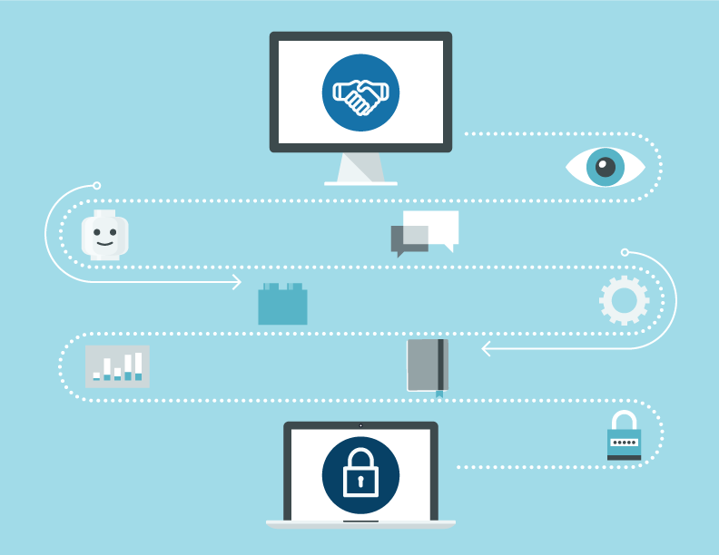
Why should I use an API?
The availability of the raw data has made it possible for 3rd party developers to release phone apps that display the same data with custom presentation.
Some APIs, like the Reddit and Spotify APIs, are designed to expand the reach of the organization by making their data available to users, and enabling external developers to build products that are in some way reliant on the business, and so keep customers coming back.

Slide 10
What is synchronous/asynchronous methods
Synchronous method
An API may be synchronous where data or service availability, resources and connectivity are high and low latency is a requirement.
Asynchronous method
An API may be asynchronous where data or service availability and connectivity are low or oversaturated with demand.

Slide 11
sync method

Slide 12
async method

Slide 13
Types of APIs
Open APIs :- They are publicly available to developers and other users with minimal restriction.
Partner APIs :- They are not available publicly and need specific entitlement to access them.
Internal APIs :- They are hidden from external users and only exposed by internal systems.

Slide 14

API specifications/protocols
Remote Procedure Call (RPC)
XML-RPC
JSON-RPC
Service Object Access Protocol (SOAP)
Representational State Transfer (REST)

Slide 15
Remote Procedure Call (RPC)
XML-RPC:
XML stands for Extensible Markup Language.
It’s very similar to HTML.
XML format :-
<KEY> value </KEY>
JSON-RPC:
JSON stands for JavaScript Object Notation.
It’s similar to JavaScript.
JSON format :-
{KEY : value}

Slide 16
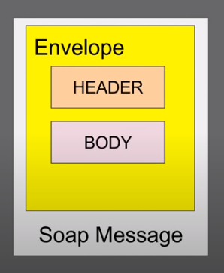
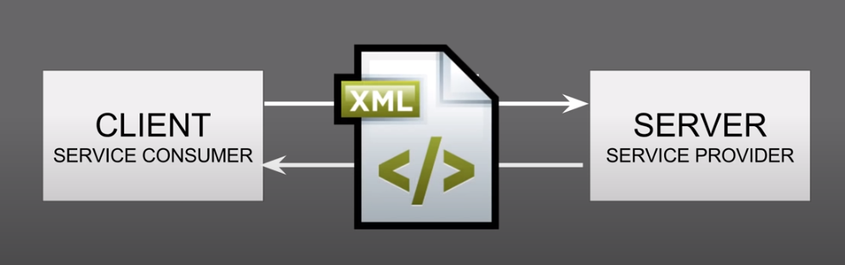
Service Object Access Protocol (SOAP)
This is a protocol that uses XML as a format to transfer data.
Its main function is to define the structure of the messages and methods of communication.
It also uses WSDL, or Web Services Definition Language, in a machine-readable document to publish a definition of its interface.

Slide 17
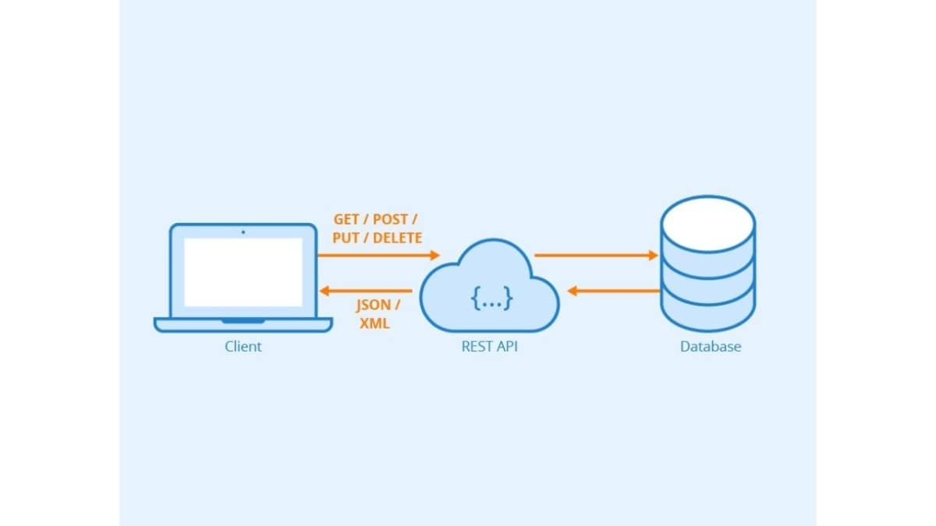
Representational State Transfer (REST)
REST is a protocol like the other web services, also it is a set of architectural principles.
The REST service needs to have certain characteristics, including simple interfaces, which are resources identified easily within the request and manipulation of resources using the interface.

Slide 18
The differences between SOAP and REST?
SOAP | REST
It has strict rules and advanced security to follow. | There are loose guidelines to follow allowing developers to make recommendations easily
It is driven by Function | It is driven by Data
It requires more Bandwidth | It requires minimum Bandwidth

Slide 19
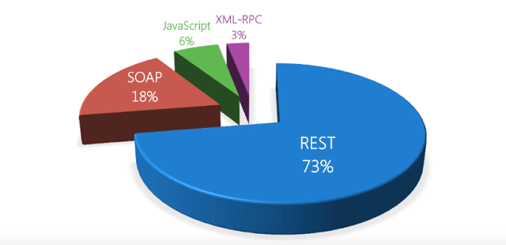
Enterprise analysis

Slide 20
Thank You

